Slide 1

Stephen Mather, GIS Manager, Cleveland Metroparks
@smathermather, svm@clevelandmetroparks.com

Slide 2
OpenDroneMap is an open source toolkit for aerial drone imagery.
It is modern photogrammetry - fully automated matching, digital surface modeling, and mosaicking

Slide 3
In preparation for the robot takeover.

Slide 4
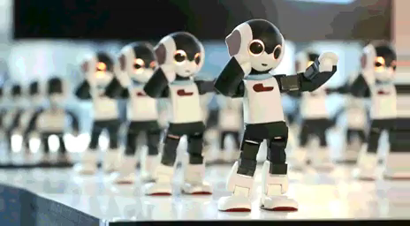
Preparation for the Robot Takeover
Why?
https://imgur.com/gallery/azyruE3

Slide 5
The Future

Slide 6
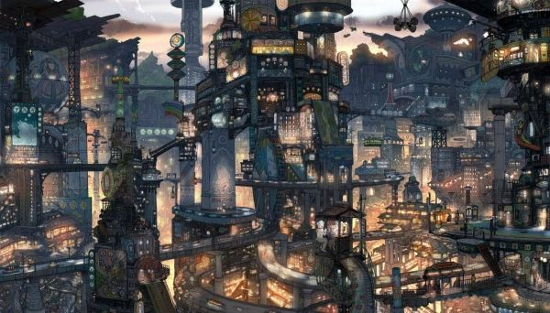
https://s-media-cache-ak0.pinimg.com/736x/61/f0/37/61f037cb982dbd3d9720a107e9373b01.jpg

Slide 7
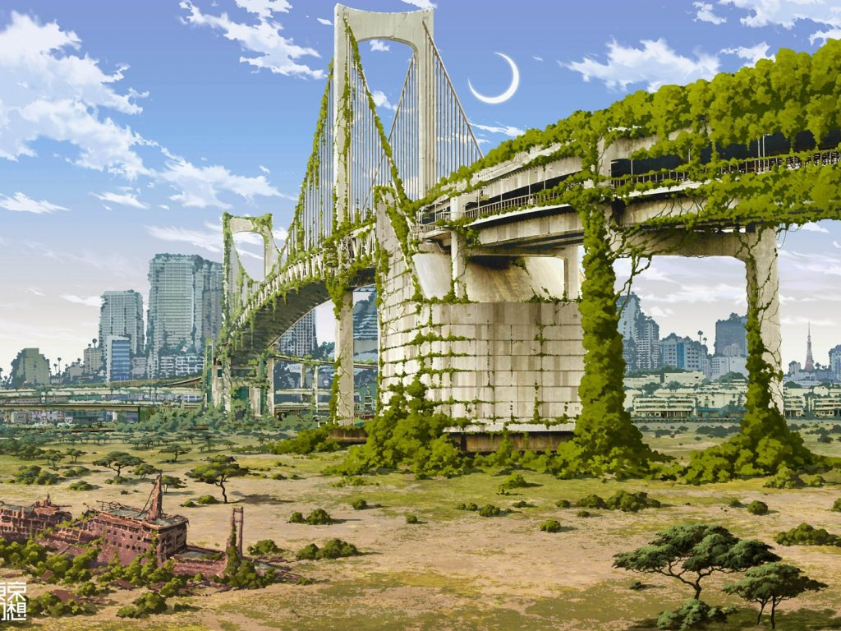
https://www.walldevil.com/6554-bridges-cities-crescent-moon-fantasy-futuristic-japan-landscapes-moss-nature-postapocalyptic-rainbow-bridge-ruins-ships-tokyo-tokyogenso-vehicles.html

Slide 8
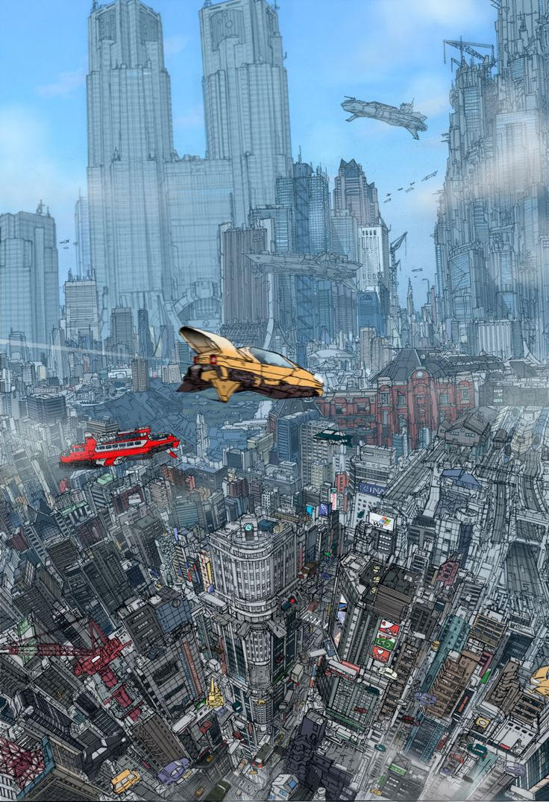
https://s-media-cache-ak0.pinimg.com/736x/36/a5/e7/36a5e797df79b8ed4931d40dc75c0084.jpg

Slide 9
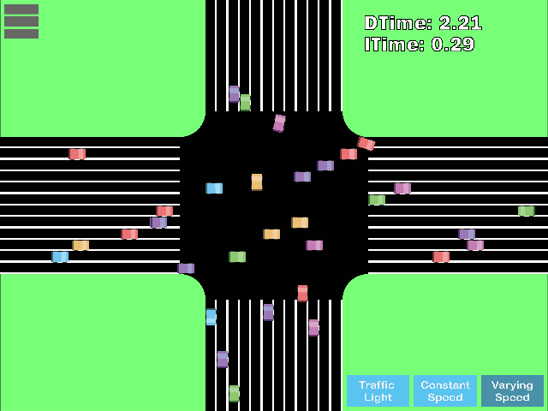

Slide 10
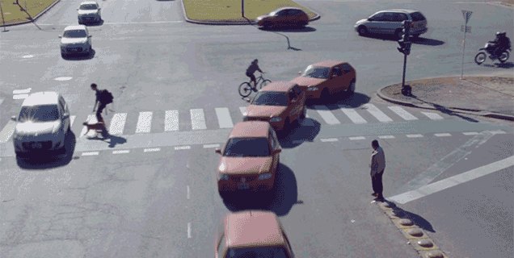

Slide 11
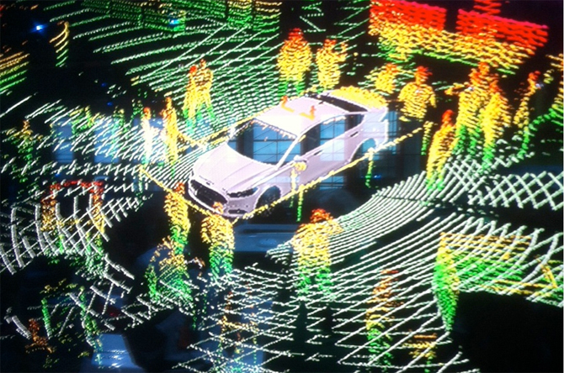

Slide 12
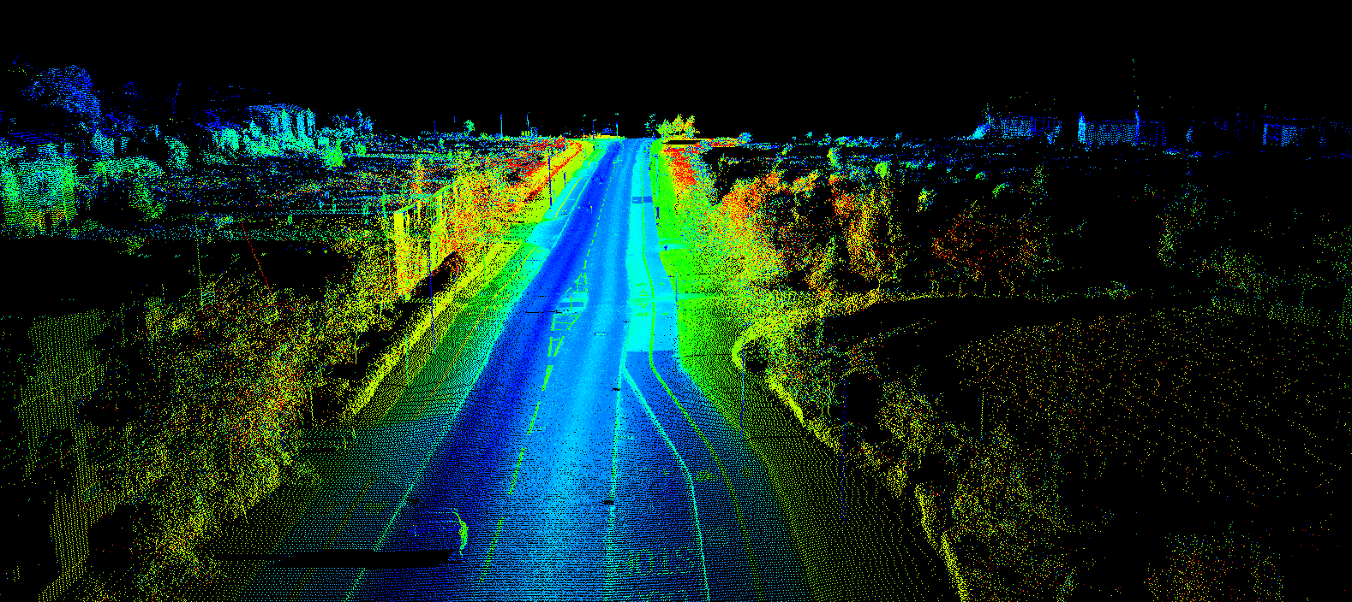
http://www.renishaw.com/media/img/gen/9a5511617ef7479a8d3ddc0917dc5b6d.png

Slide 13
OpenDroneMap is an open source toolkit for aerial drone imagery.
It is modern photogrammetry - fully automated matching, digital surface modelling, and mosaicking
Platform vs. Toolkit

Slide 14
Origins
Computer Vision
Photogrammetry
Notes:
OpenDroneMap originates from Computer Vision, i.e. how do we enable computers to navigate and understand the world.
It depends on stereo vision much like we do to make sense of the world in 3D

Slide 15
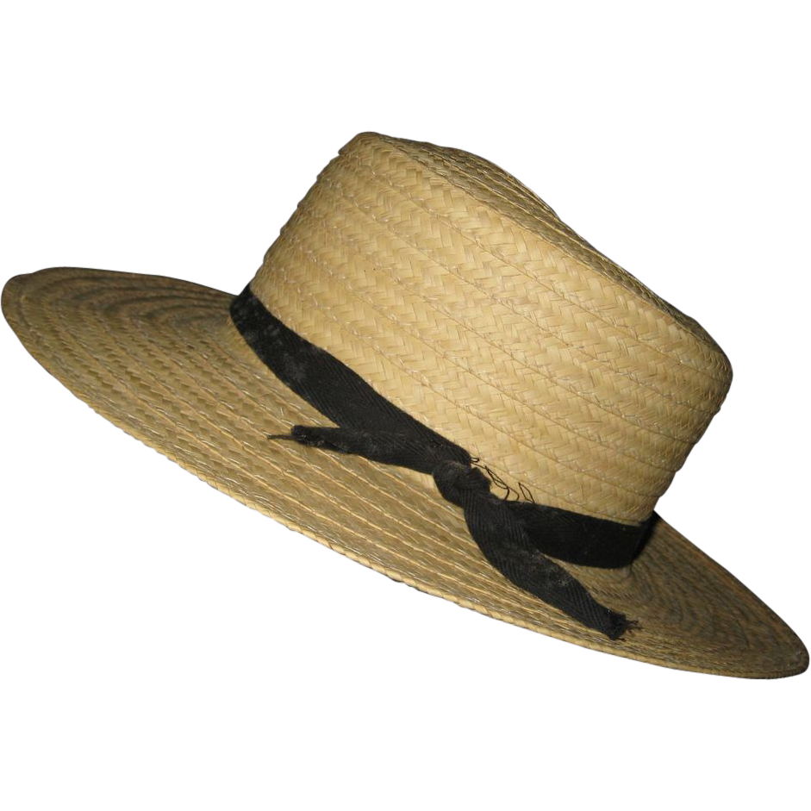
Purposes
Ecology
Humanitarian
Participatory creation of data for the public good
http://image0-rubylane.s3.amazonaws.com/shops/suzanstreasures/VCx20-x201402.1L.jpg
Notes:
OpenDroneMap originates from Computer Vision, i.e. how do we enable computers to navigate and understand the world.
It depends on stereo vision much like we do to make sense of the world in 3D

Slide 16
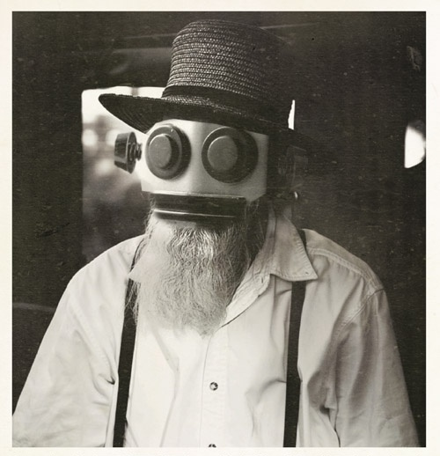
This complicates my robot narrative…
https://s-media-cache-ak0.pinimg.com/736x/a7/9a/73/a79a731eea0f09d09c012856914e74dc.jpg

Slide 17
ODM and the photogrammetric process
Structure from Motion
Point Cloud Densification
Poisson Surface Reconstruction
Multi-View Stereo Texturing
Orthophoto Generation

Slide 18
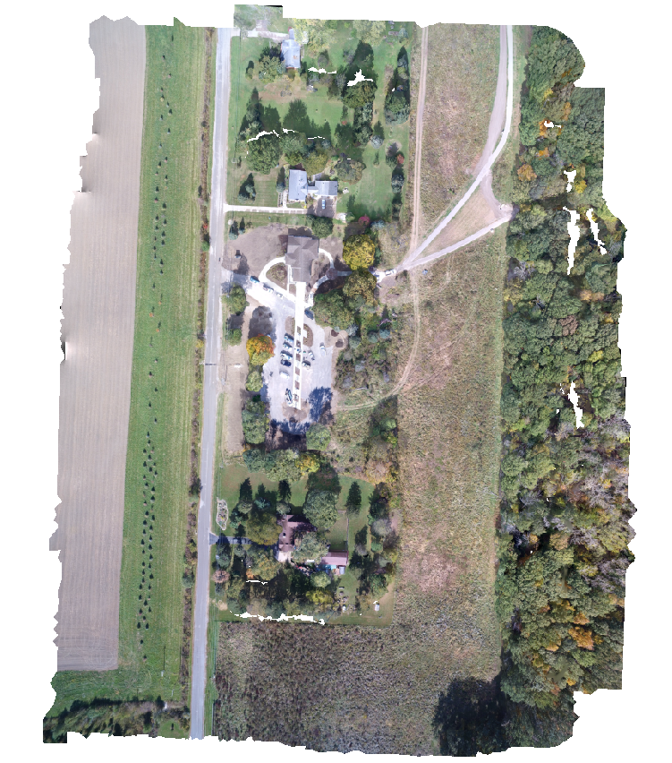
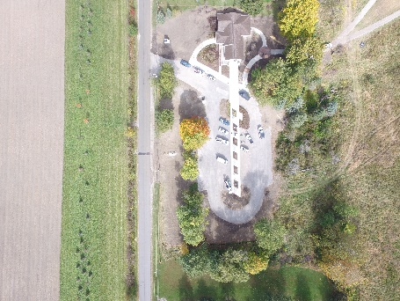
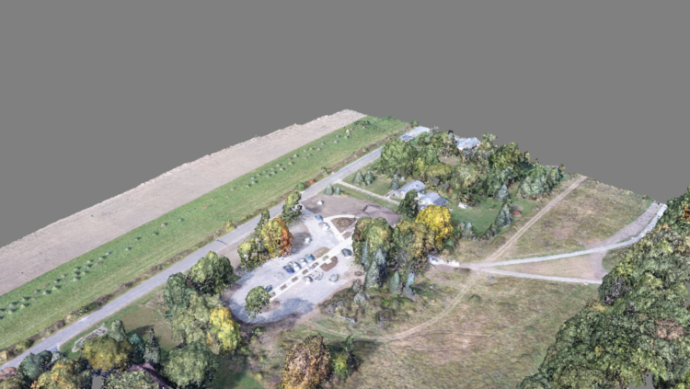
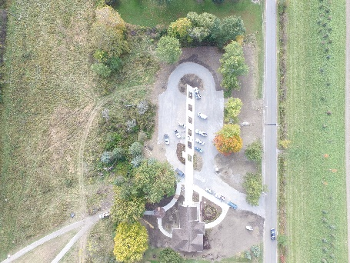
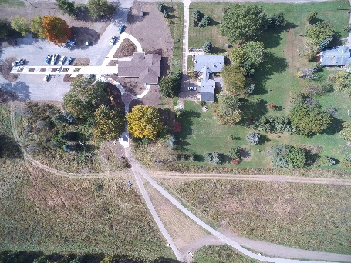
Photogrammetric Process
Notes:
Steve on photogrammetry

Slide 19
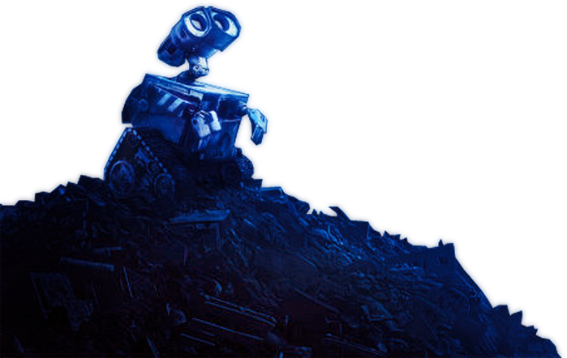
Questions you may be asking:
This is great, Steve. How do I get started in collecting the necessary datasets for the robot takeover?
https://photoshopstar.com/graphics/wall-e-cartoon-style-wallpaper/

Slide 20
How to Use OpenDroneMap

Slide 21
Installation
There are many ways to install ODM:
Natively using Ubuntu 14.04 or later (or with Virtual Machine via vagrant)
Linux, MacOS or Windows, by installing Docker
See project: OpenDroneMap.org

Slide 22
Usage
Command line tool
Web
Portable OpenStreetMap (POSM)
nodeOpenDroneMap
WebODM
API Docs: https://opendronemap.github.io/WebODM/
opendronemap-ecs
“serverless”

Slide 23
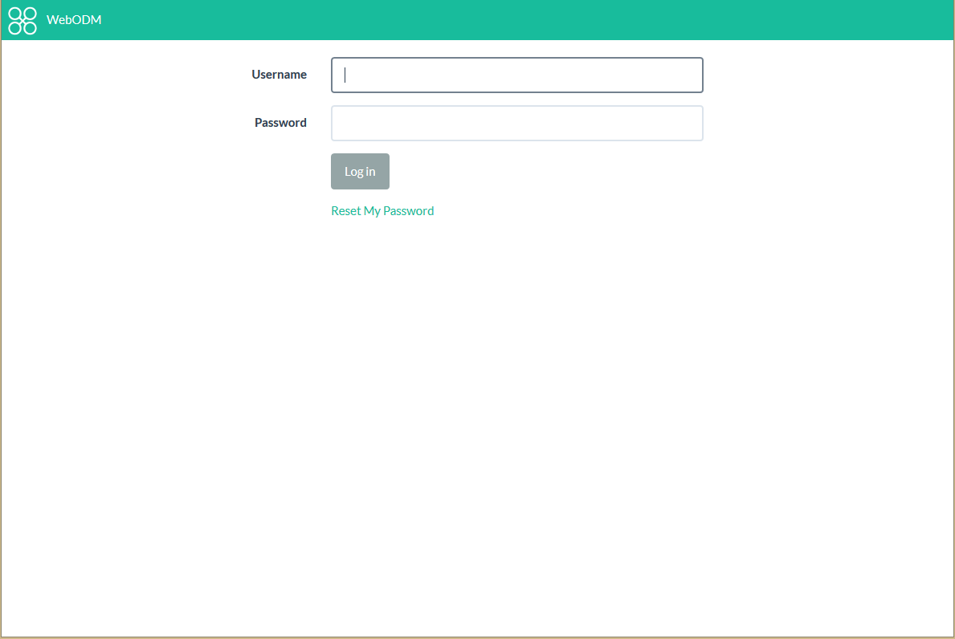

Slide 24
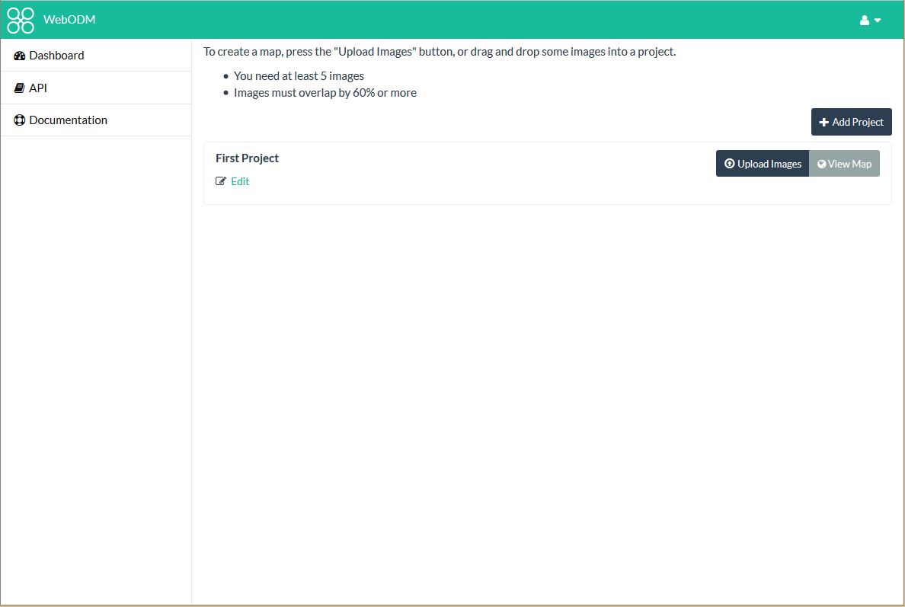

Slide 25
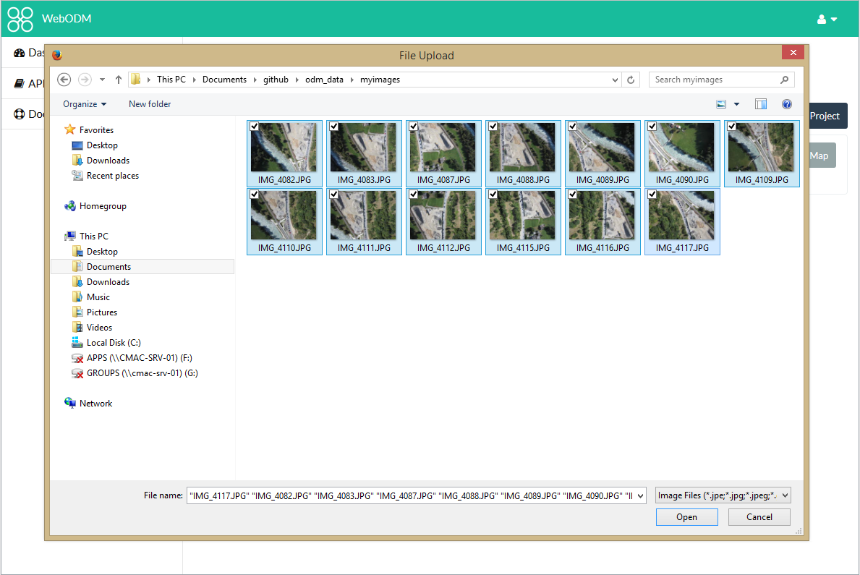

Slide 26
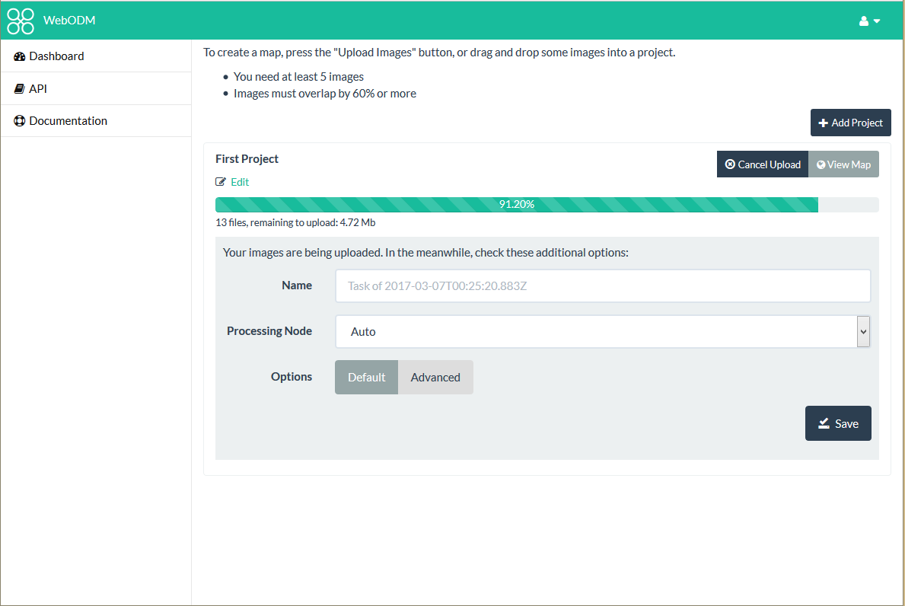

Slide 27
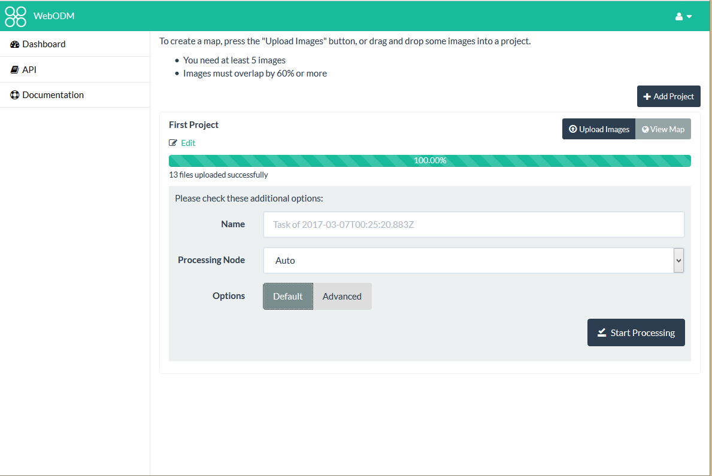

Slide 28
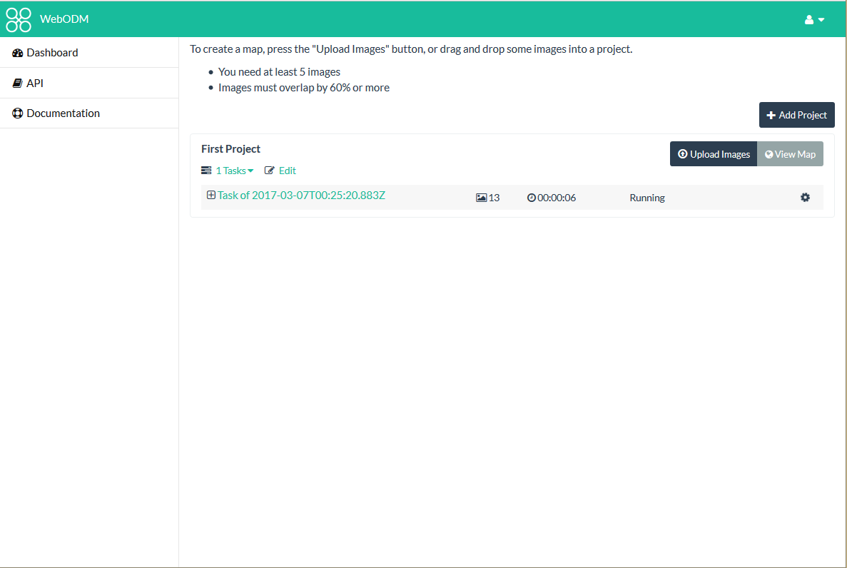

Slide 29
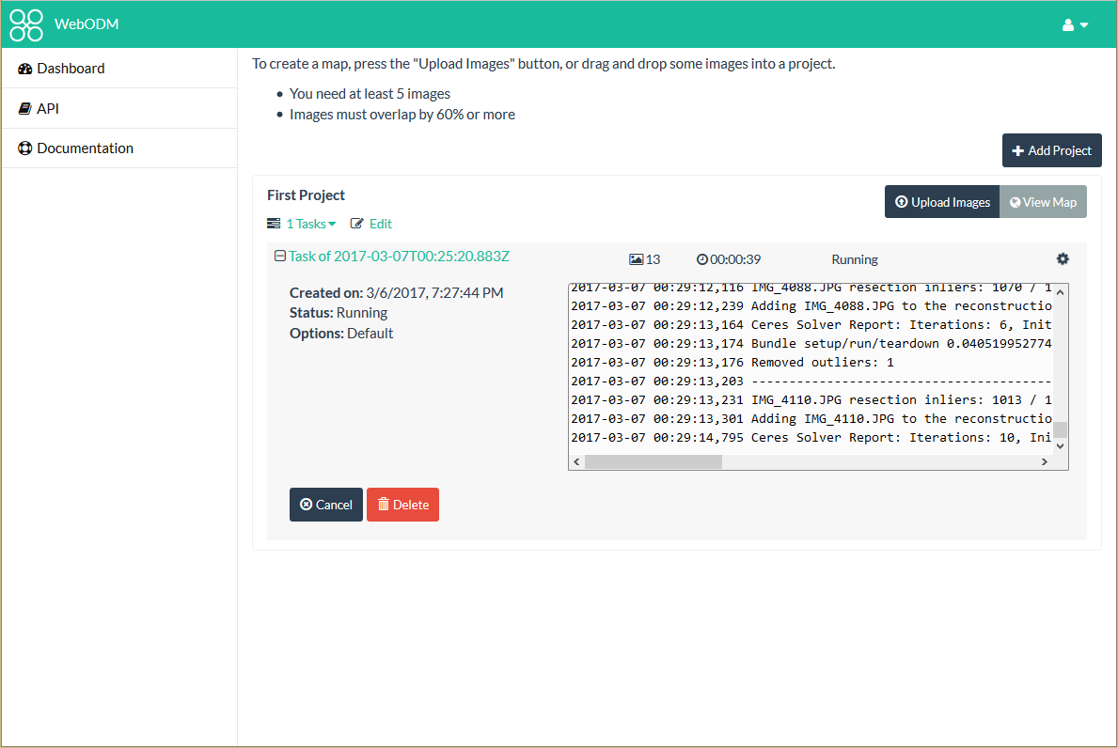

Slide 30
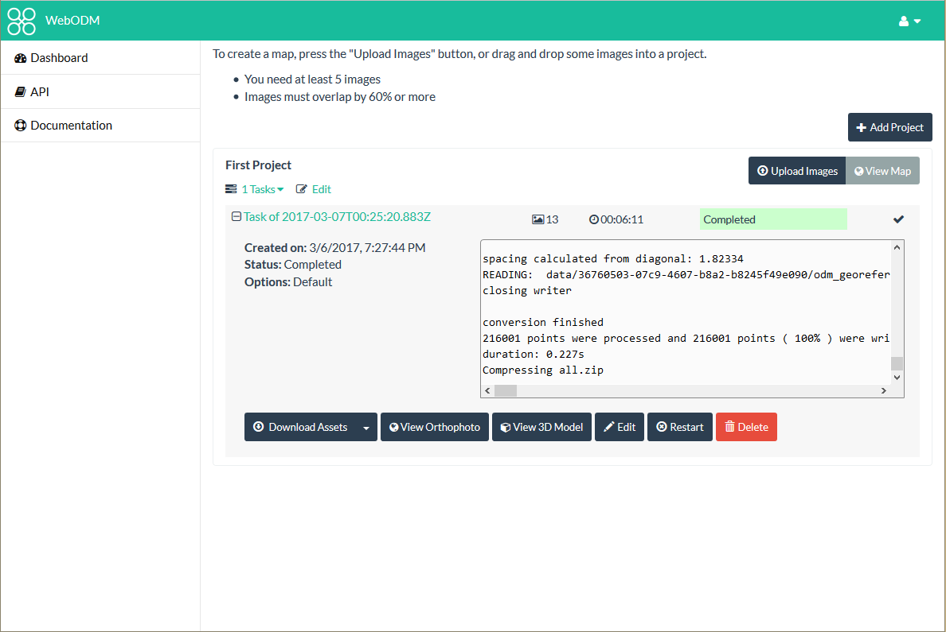

Slide 31
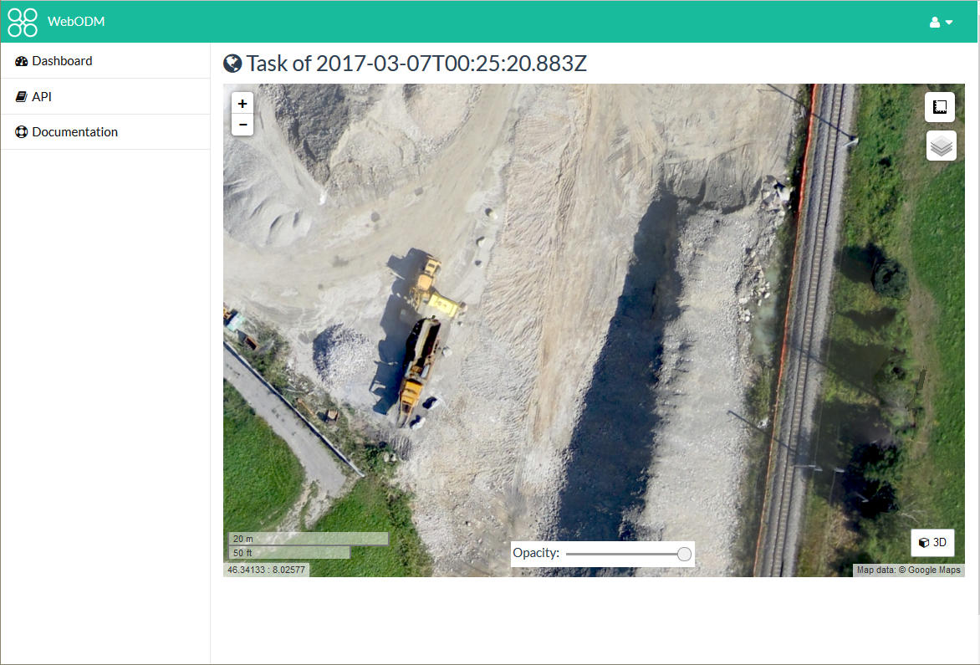

Slide 32
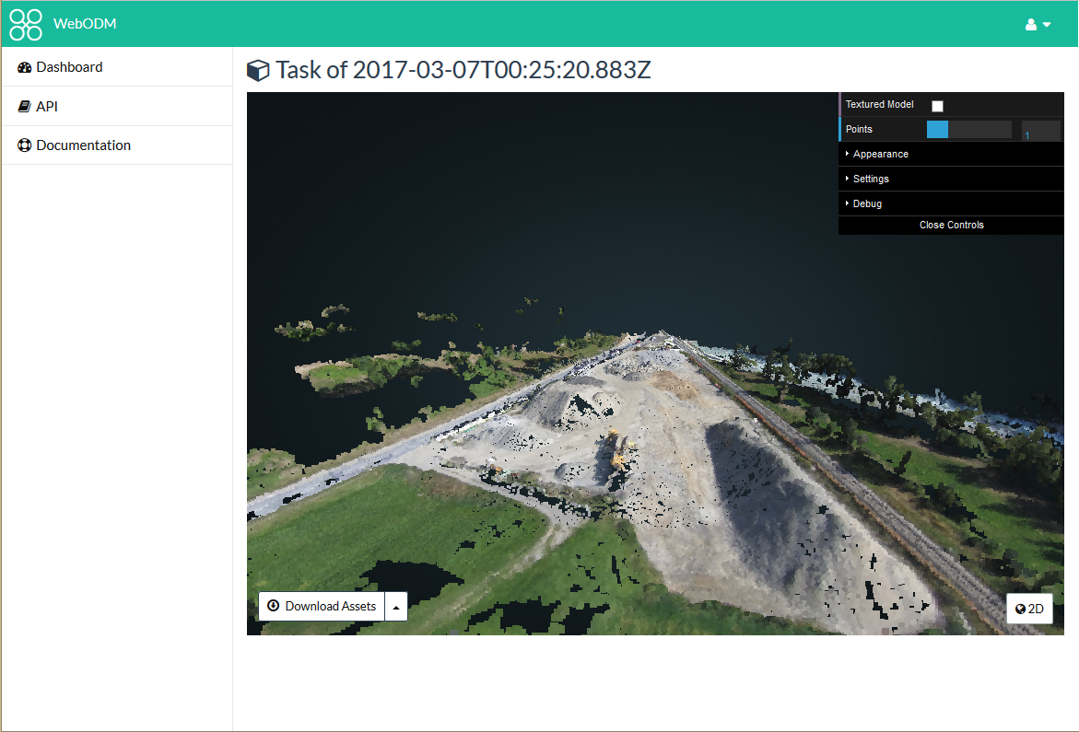

Slide 33
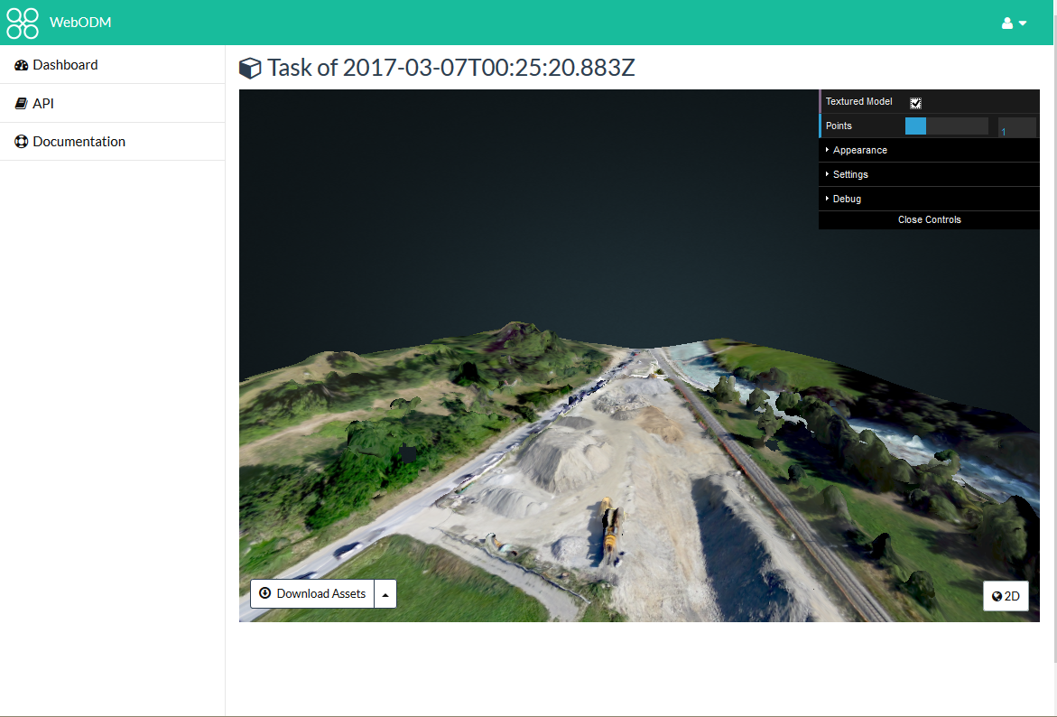

Slide 34
Funding and Future

Slide 35
Funding
Cleveland Metroparks
American Red Cross
Integration with Portable OpenStreetMap (POSM)
Humanitarian Innovation Fund
Make ODM Easier to Use
Make the products from it better / more accurate
World Bank Tanzania

Slide 36
OpenDroneMap: Future
Quality and robustness improvements
Scalability
Reduce memory footprint
Data Partitioning
Analysis
Add automated DTM extraction
Classification
Mesh improvements

Slide 37
DTM Extraction
Near future

Slide 38
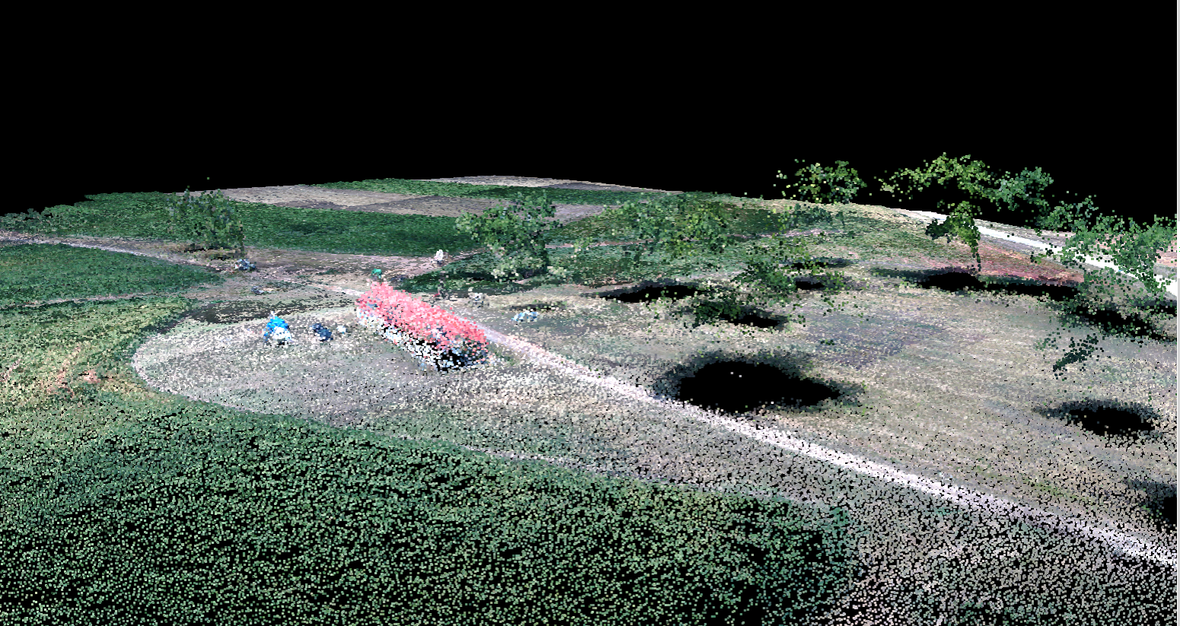
Midpines, flown by NextGen Air Transportation Center (NGAT) access to the data through collaboration with Center for Geospatial Analytics at NCSU

Slide 39
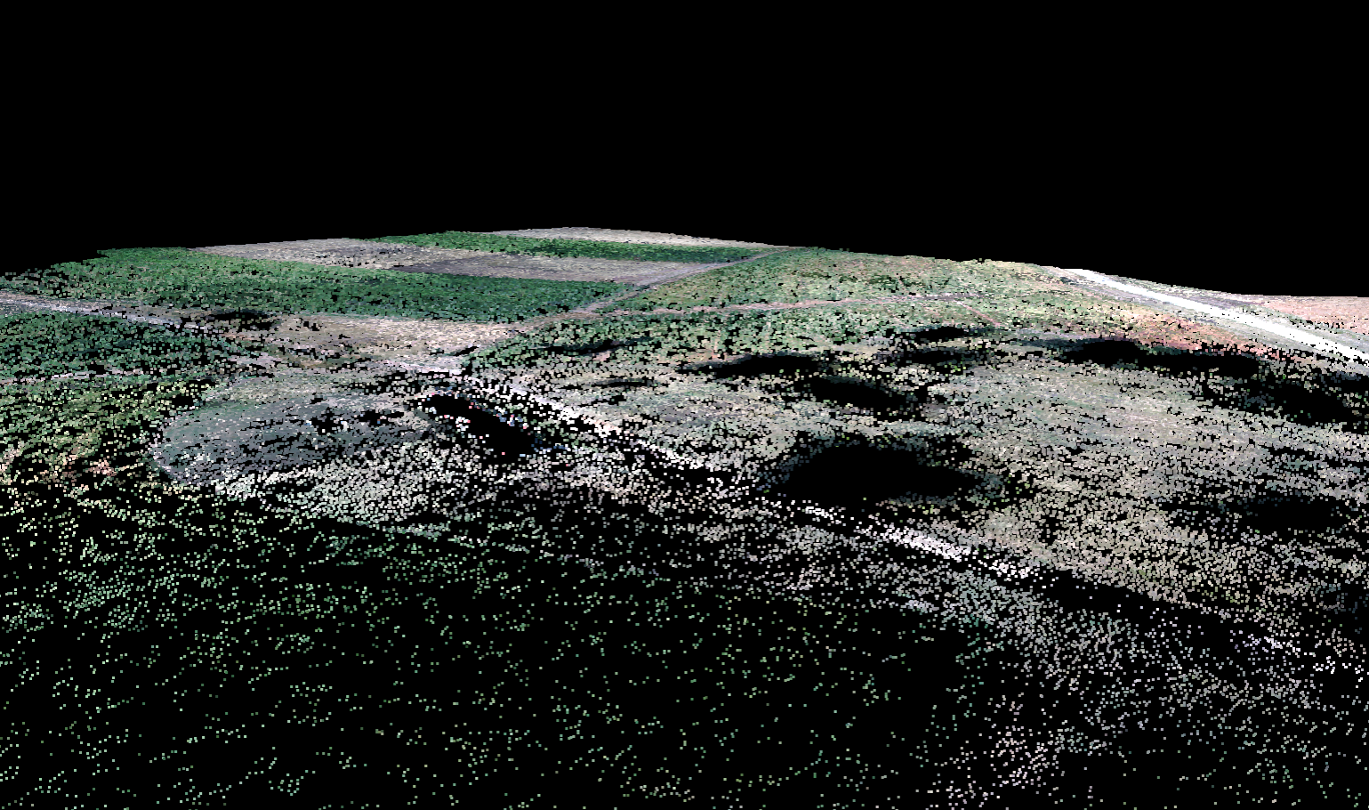
Midpines, flown by NextGen Air Transportation Center (NGAT) access to the data through collaboration with Center for Geospatial Analytics at NCSU

Slide 40
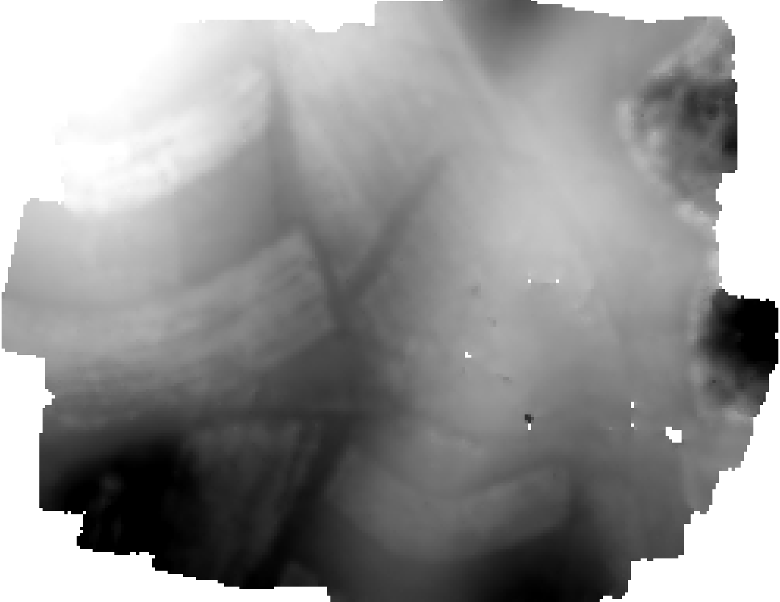
Midpines, flown by NextGen Air Transportation Center (NGAT) access to the data through collaboration with Center for Geospatial Analytics at NCSU

Slide 41
Near-term improvements
Quality reporting and robustness improvements
Incremental optimizations
Large-scale pipeline

Slide 42
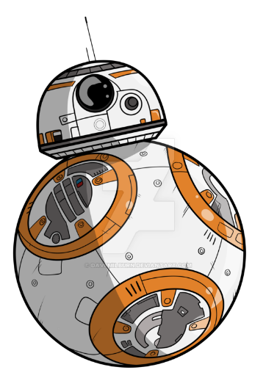
Quality reporting and robotness improvements
Add reporting system to OpenSfM
Collect metadata on Structure from Motion Process
Number of matches, Matching graph between images, Number of reconstructed images and points, Histogram of reprojection errors, Memory Usage, etc.
Improve Robotness
Analyze and classify failures
Improve results on difficult datasets
Establish test datasets for ongoing testing
http://davemilburn.deviantart.com/art/BB8-586862785

Slide 43
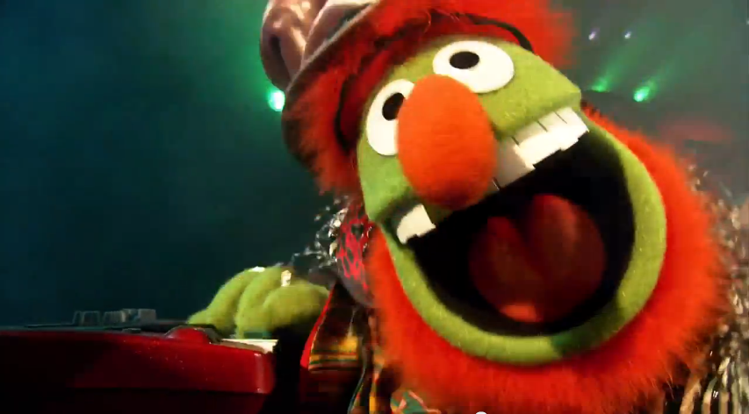
Large-scale pipelineor breaking datasets into bite-size pieces
Split large numbers of images into smaller groups
Run OpenSfM reconstruction on each subgroup
Align and transform those groups to each other using matching features between the groups

Slide 44
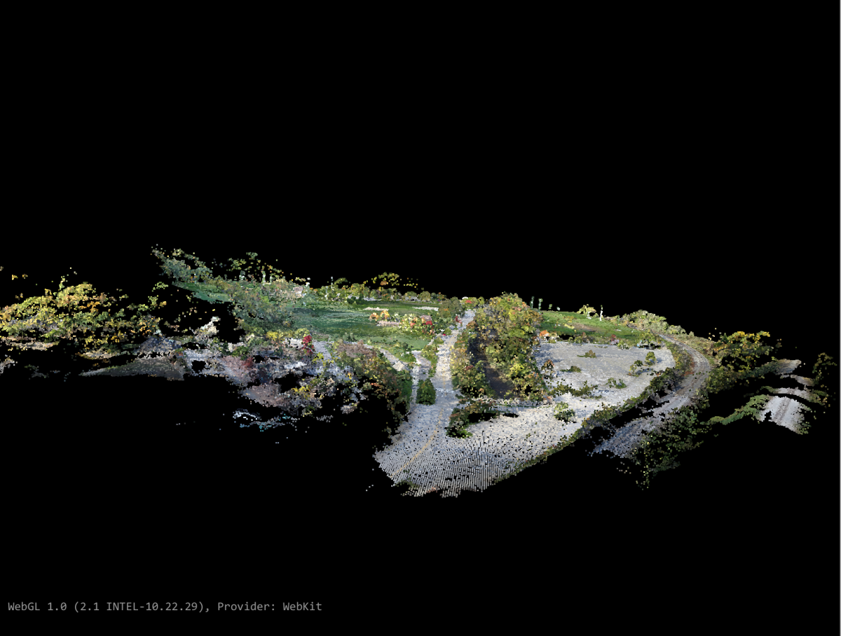
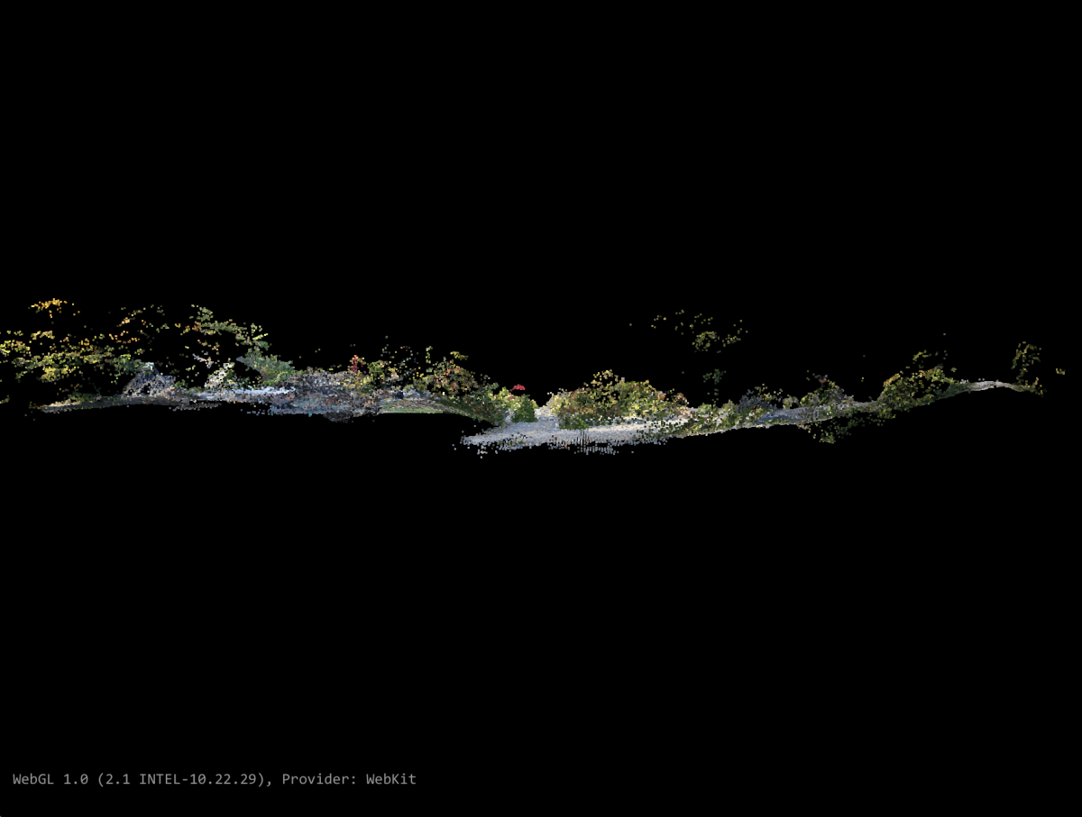
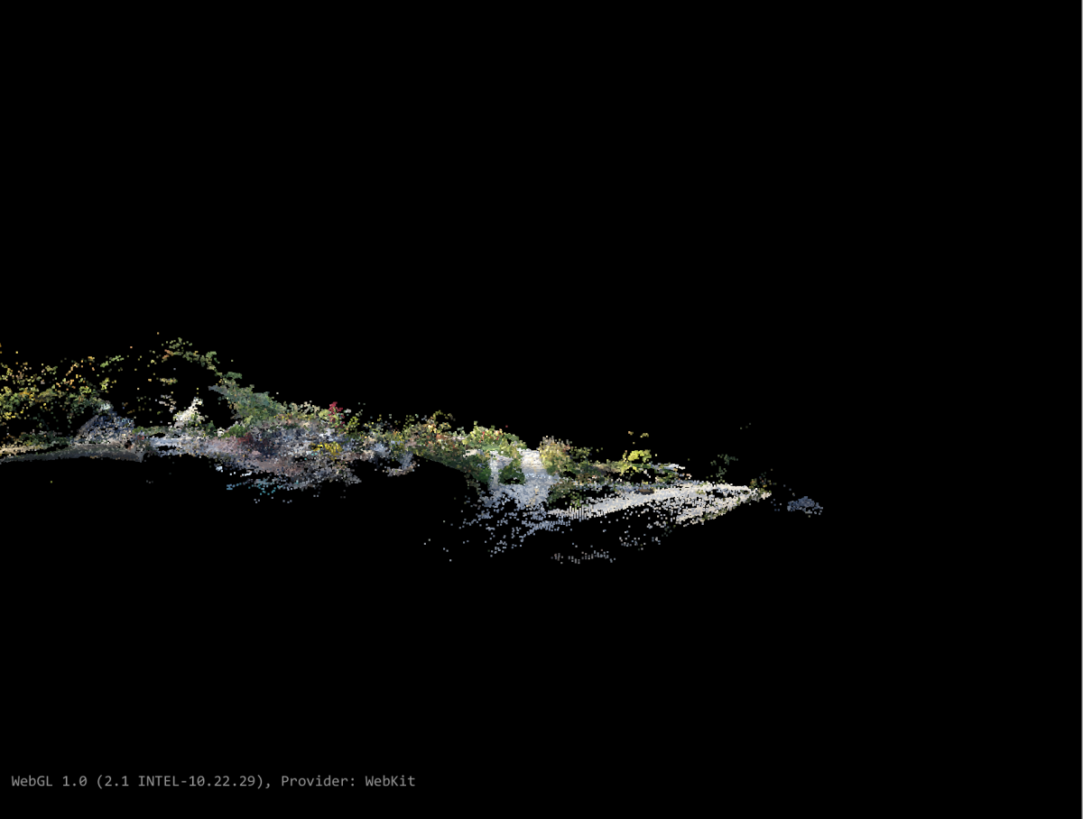
Large-scale pipelineor breaking datasets into bite-size pieces

Slide 45
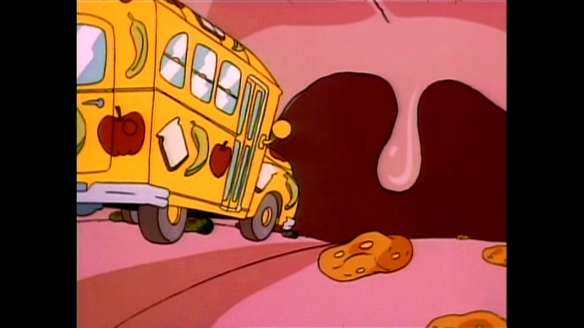
Incremental optimizations or what happens after it’s down the gullet
Improve processor use
Cascade Hashing¹ matching
or
Bag of Words²
Improved Memory Use:
Improved correspondence graph data structures
SLAM-like pose-graph methods for global adjustment of camera position
[1] Jian Cheng, Cong Leng, Jiaxiang Wu, Hainan Cui, Hanqing Lu; The IEEE Conference on Computer Vision and Pattern Recognition (CVPR), 2014, pp. 1-8
[2] Michal Havlena, Konrad Schindler; VocMatch: Efficient Multiview Correspondence for Structure from Motion; Institute of Geodesy and Photogrammetry, ETH Zurich, Switzerland

Slide 46
WebODM: Future
DEM display
Volumetric Measurements
Mission Planning
Mobile App for autonomous flight
QGIS integration
Integration with Entwine + Greyhound
Integration with OpenAerialMap

Slide 47
Use Case

Slide 48
Zanzibar Mapping Initiative

Slide 49
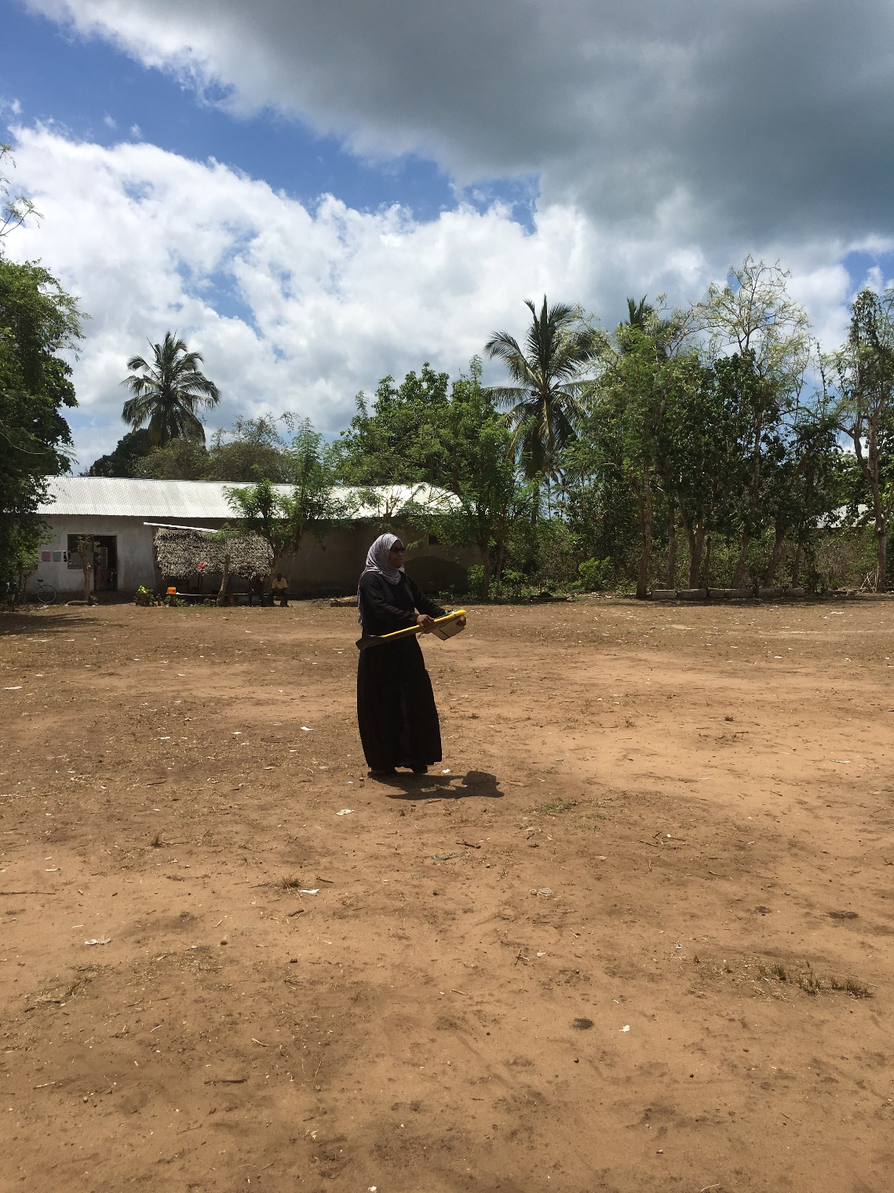
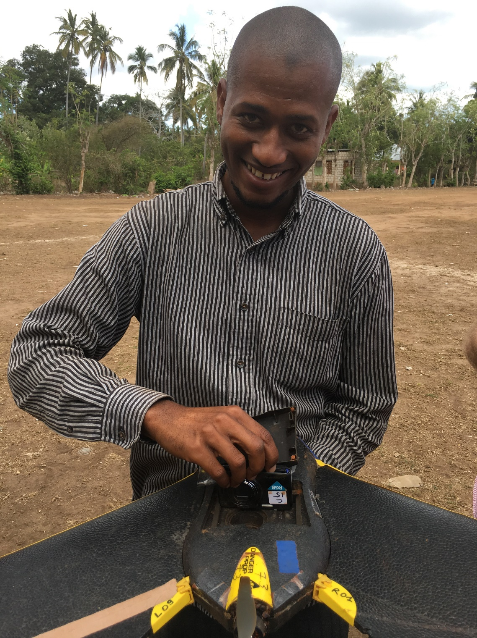

Slide 50
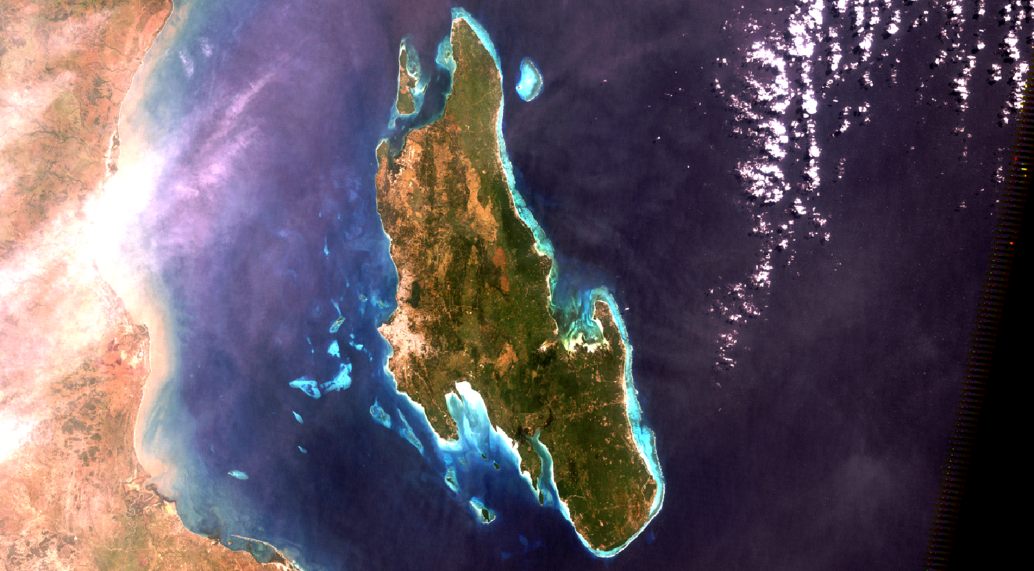

Slide 51
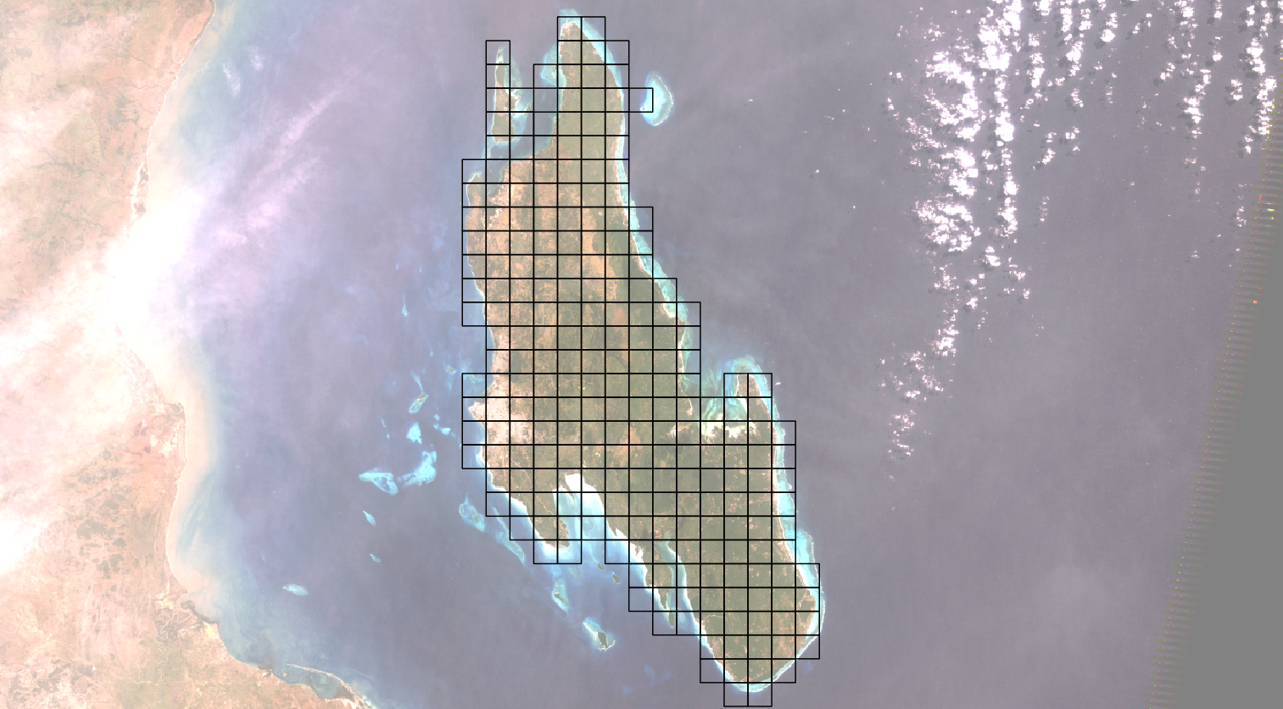

Slide 52
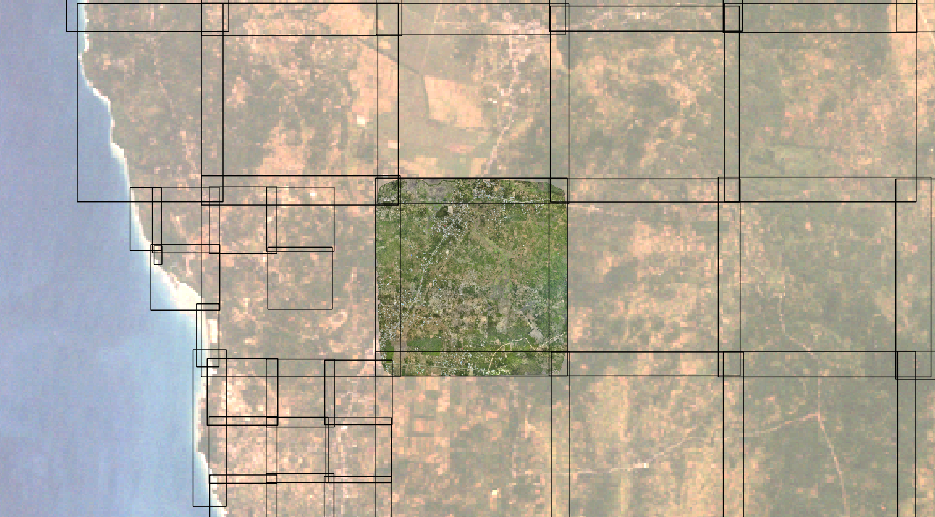

Slide 53
Compounding Z error across large landscape

Slide 54
Corrected Z error across large landscape

Slide 55
Questions

Slide 56
Stephen Mather, GIS Manager, Cleveland Metroparks
@smathermather, svm@clevelandmetroparks.com

